Slide 1


Work Experience Presentation
Alexa Cairns-Radicke
Dimitrina Grazhdani
Safaa Abdulahi
16 Feb 2024
Notes:
Ricky

Slide 2
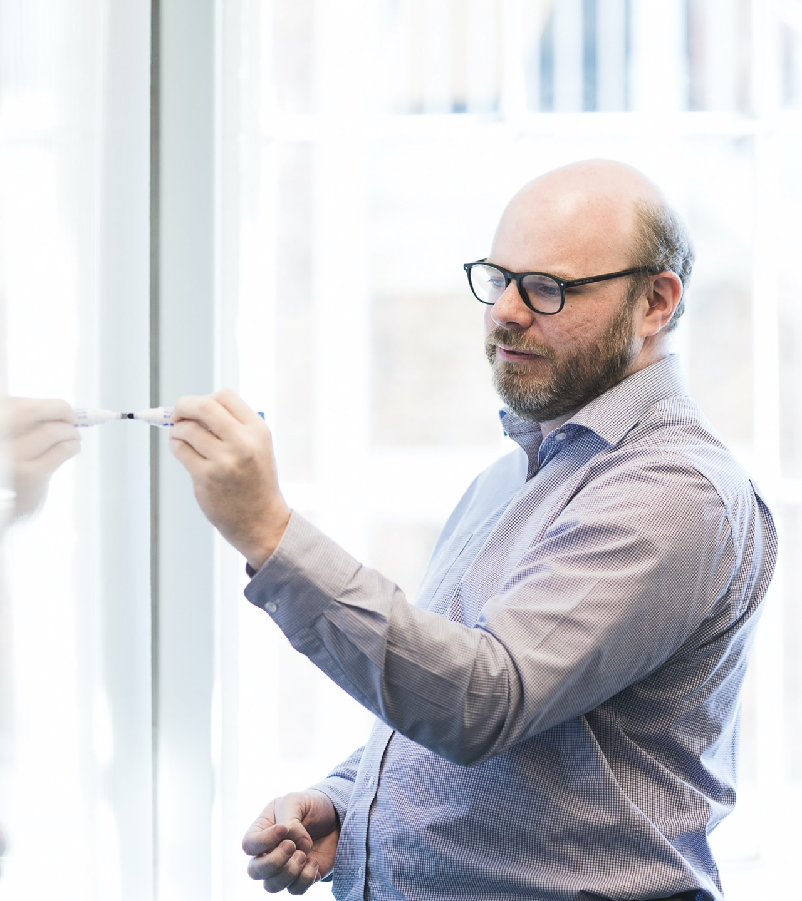
Agenda
1 | What we started with
2 | Where we are now
3 | Challenging bits
4 | Fun bits
5 | If we had more time…
6 | We’ve learnt…
7 | Our plea
8 | THANK YOU
Notes:
Dimitrina

Slide 3
Where we started
Original website
Notes:
Safaa

Slide 4
Where are now
Website
Features
Dark background for colour contrast
Lots of pink
Back story of each dinosaur
Background music - plays automatically and loops infinitely
Spinning dinosaurs used CSS animation
The layout of the page uses CSS flexbox
3D-looking title when you hover - used CSS text-shadow and transition
Linking the home page and the game page
Tetris (obviously)
Notes:
Safaa - css stuff
Dimi & Alexa - tetris stuff

Slide 5
Challenging bits
Coding in general…
Finding errors - spelling errors etc
Understanding git at the start
Playing Tetris
Functions - where to use them / make them
Maths to work out positions / grid
Notes:
Alexa

Slide 6
Fun bits
Safaa won a lot of card games
Progress - pool and ping pong
Lunches were tasty and healthy
Free food / drinks
Meeting new people, presentations
Coding was fun – well, it was fun when it works
Creative freedom
Notes:
Safaa

Slide 7
If we had more time…
When the user completes an entire line, remove it
Make it friendly on mobile – not just keyboard input
Build a backend and save scores
Display the next block in the small grid
Other small bits:
Add a stopwatch / point system
Game over screen
Difficulty levels - change block speed
Button to stop playing music
More styling e.g. make dinosaurs move around while playing
Notes:
Dimi

Slide 8
We’ve learnt…
javascript in general - map etc
git / Github
Talks
Accessibility - Aya
Security - Sarah B
Career switch - Kiran
Recruitment - Frances
Apprenticeships – Joe W
Notes:
Dimi

Slide 9
Our plea
Can we please come back? We’re nice…

Slide 10




THANK YOU

Slide 11



Name Surname
Job title
name@softwire.com
00000 000 000
0207 485 7500
Suite 315, Highgate Studios
53-79 Highgate Road
London NW5 1TL
Copyright © Softwire 2022
All rights reserved

Slide 12
Click on the links below for brand guidelines and imagery
Brand guidelines
Softwire office shoot
Staff headshots
Iconography
Free stock imagery

Slide 13
Presentation title runs here
Name Surname
00 Month 2021

Slide 14
Slide title runs here
This is level 1 text
This is level 2 text
This is level 3 text
This is level 4 text
This is level 5 text

Slide 15
Slide title runs here
This is level 1 text
This is level 2 text
This is level 3 text
This is level 4 text
This is level 5 text

Slide 16
Agenda
1 | Section title runs here
2 | Section title runs here
3 | Section title runs here
4 | Section title runs here
5 | Section title runs here
6 | Section title runs here
7 | Section title runs here
8 | Section title runs here

Slide 17
Agenda
1 | Section title runs here
2 | Section title runs here this layout accommodates long titles
3 | Section title runs here
4 | Section title runs here
5 | Section title runs here
6 | Section title runs here
7 | Section title runs here
8 | Section title runs here

Slide 18

Slide title runs here
This is display text it is not here to be read it is here to show how this document will look when populated with real text. This is display text it is not here to be read it is here to show how this document will look when populated with real text. This is display text it is not here to be read it is here to show how this document will look when populated with real text.
Bulleted text
Bulleted text
Bulleted text

Slide 19
Slide title runs here
This is display text it is not here to be read it is here to show how this document will look when populated with real text. This is display text it is not here to be read it is here to show how this document will look when populated with real text. This is display text it is not here to be read it is here to show how this document will look when populated with real text.
Bulleted text
Bulleted text
Bulleted text

Slide 20
Slide title runs here
This is display text it is not here to be read it is here to show how this document will look when populated with real text. This is display text it is not here to be read it is here to show how this document will look when populated with real text. This is display text it is not here to be read it is here to show how this document will look when populated with real text.
Bulleted text
Bulleted text
Bulleted text

Slide 21
Slide title runs here
This is display text it is not here to be read it is here to show how this document will look when populated with real text. This is display text it is not here to be read it is here to show how this document will look when populated with real text. This is display text it is not here to be read it is here to show how this document will look when populated with real text.
Bulleted text
Bulleted text
Bulleted text

Slide 22
Slide title runs here
This is display text it is not here to be read it is here to show how this document will look when populated with real text. This is display text it is not here to be read it is here to show how this document will look when populated with real text. This is display text it is not here to be read it is here to show how this document will look when populated with real text.
Bulleted text
Bulleted text
Bulleted text
This is display text it is not here to be read it is here to show how this document will look when populated with real text. This is display text it is not here to be read it is here to show how this document will look when populated with real text. This is display text it is not here to be read it is here to show how this document will look when populated with real text.
Bulleted text
Bulleted text
Bulleted text

Slide 23
Slide title runs here
This is display text it is not here to be read it is here to show how this document will look when populated with real text. This is display text it is not here to be read it is here to show how this document will look when populated with real text. This is display text it is not here to be read it is here to show how this document will look when populated with real text.
Bulleted text
Bulleted text
Bulleted text
This is display text it is not here to be read it is here to show how this document will look when populated with real text. This is display text it is not here to be read it is here to show how this document will look when populated with real text. This is display text it is not here to be read it is here to show how this document will look when populated with real text.
Bulleted text
Bulleted text
Bulleted text

Slide 24
Title runs here
This is quotation text it is not here to be read. This is display text it is not here to be read it is here to show how this document will look when populated with real text…”
Name Surname, Company

Slide 25
Title runs here
This is quotation text it is not here to be read. This is display text it is not here to be read it is here to show how this document will look when populated with real text…”
Name Surname, Company

Slide 26

The team
Name Surname
Job title
This is display text it is not here to be read it is here to show how this document will look when populated with real text. This is display text it is not here to be read it is here to show how this document will look when populated with real text. This is display text it is not here to be read it is here to show how this document will look when populated with real text.
Bulleted text
Bulleted text

Slide 27
The team
Name Surname
Job title
This is display text it is not here to be read it is here to show how this document will look when populated with real text. This is display text it is not here to be read it is here to show how this document will look when populated with real text. This is display text it is not here to be read it is here to show how this document will look when populated with real text.
Bulleted text
Bulleted text

Slide 28



Slide title runs here
Name Surname
Job title
Name Surname
Job title
Name Surname
Job title

Slide 29
Slide title runs here
Name Surname
Job title
Name Surname
Job title
Name Surname
Job title

Slide 30




Slide title runs here
Name Surname
Job title
Name Surname
Job title
Name Surname
Job title
Name Surname
Job title

Slide 31
Slide title runs here
Name Surname
Job title
Name Surname
Job title
Name Surname
Job title
Name Surname
Job title

Slide 32

Section break title runs here
Subtitle

Slide 33
Section break title runs here
Subtitle

Slide 34
Section break title runs here
Subtitle

Slide 35

Section break title runs here
Subtitle

Slide 36
Section break title runs here
Subtitle

Slide 37
Name Surname
Job title
name@softwire.com
00000 000 000
0207 485 7500
Suite 315, Highgate Studios
53-79 Highgate Road
London NW5 1TL
Copyright © Softwire 2022
All rights reserved

Slide 38
Name Surname
Job title
name@softwire.com
00000 000 000
0207 485 7500
Suite 315, Highgate Studios
53-79 Highgate Road
London NW5 1TL
Copyright © Softwire 2022
All rights reserved

